Slide 1
EMAIL WRITING SKILLS
ROOPA RAO.M

Slide 2
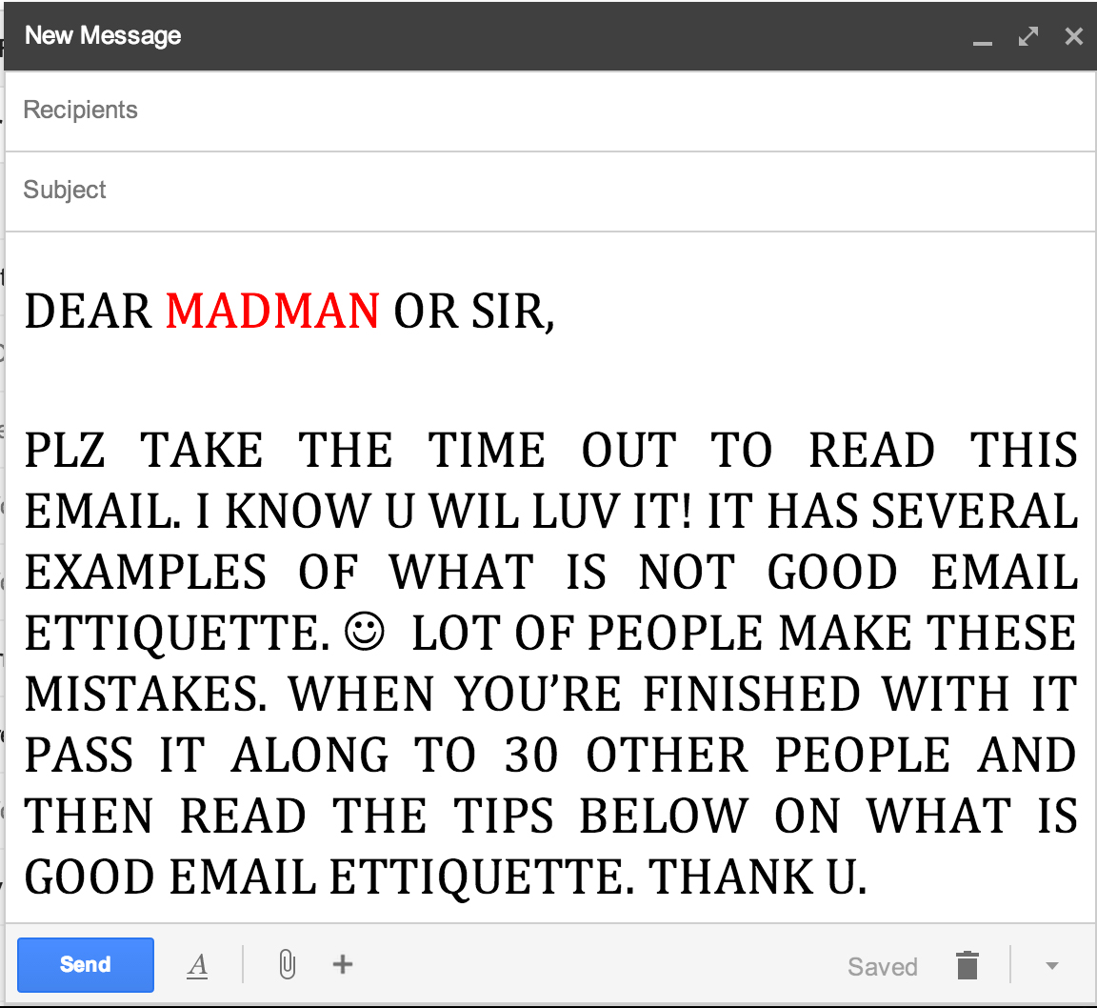
Subject: iTutor E-Learning Software
Dear Kevin
Thank you for following up on our request for more information on the iTutor authoring software.
Our IT team is currently evaluating the software through the free trial version you have provided us with. I don't think we require a demonstration of the software at this stage.
If the software meets our requirements, we will place an order.
Regards
Angela

Slide 3
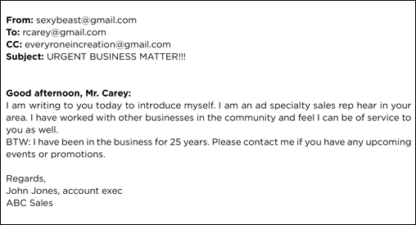
Dear Ms. Metcalfe
Further to your advertisement for the position of Administrative Assistant advertised in The South China Morning Herald on 14 December, I am interested in applying for this position.
I have attached my job application covering letter and resume.
I look forward to hearing from you.
Best regards
Suzanne Wiener

Slide 4
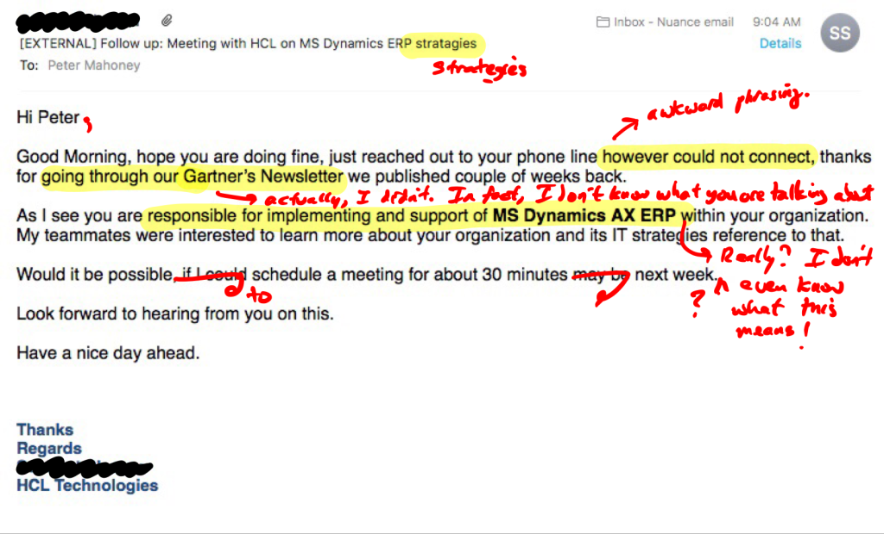
Dear Mr Chan
Thank you for your email of 12 September requesting the latest edition of our catalogue. We are pleased to inform you that we have mailed our brochure to the address you provided us with.
We would also like to inform you that it is possible to make purchases online at www.jacksonbros.com. Furthermore, you will receive a discount of 10% for any purchases made online.
We look forward to welcoming you as our customer.
Best regards
Jillian Robinson

Slide 5
Useful email opening lines Opening line mentioning the last contact between you
Thank you for your email (yesterday/ of 12 May) about…
Thanks for your email this morning/ earlier/ yesterday/ on Monday/ last week/…
Thanks for your quick reply./ Thanks for getting back to me so quickly.
Thanks for your phone call this morning/ the information about/ your interest in/ your help with/ your hospitality in…/…
Thanks for sending me/ for contacting me about/ for attending/ asking us about/ informing us/ giving us feedback on/ inviting me to/ talking to me about…
It was great/ so nice to see you again on Monday.
(I) just read your email about/ (I) just got your message about/ (I) just got your request for…
It was a pleasure/ my great pleasure to meet you last week.
Sorry for my late reply/ Sorry it took me so long to get back to you/ Sorry not to reply sooner (but/ but I had to…).
Thank you for finding the time to meet me/ talk to me/ attend…
Sorry it’s been so long since I was last in touch/ since my last email.

Slide 6
Reference emails
With reference to our telephone conversation today, I am writing to
I am writing in reference to your advertisement in yesterday's New York Times
Following our telephone conversation this morning, I would just like to ask

Slide 7
Opening line with the subject of the email
I’m writing to you about your latest model/ about the meeting next week/ about your presentation yesterday/ about…
I am writing to you in connection with/ with regards to/ regarding/ concerning…
I’m writing (in order) to ask/ to enquire/ to confirm/ to check/ to inform you/ to follow up on/ to let you know/ to tell you/ to thank you/ to invite you to/ to update you on/ to announce that/ to ask for a favour/ to…
(This is) just a quick note to say…
As promised/ As we discussed, I’m writing to send you/ to…
I’m writing (to you) because I have just found out that/ because I thought you’d like to know that/ because I need/ because…
Sorry to write out of the blue, but…
Sorry to write again so quickly, but/ Sorry to bother again so soon, but…
Sorry, in my last email I forgot to…

Slide 8
SOCIAL OPENINGS
Social opening line/ Friendly opening line
(I) hope you had a good weekend/ a good evening/ a good trip (to...)/ a good time/ a good holiday/ a good break/ a good…
How’s it going?/ How are things?/ How’s life?/ How are you doing?
I hope you (and your family) are (all) well.
4) I hope this finds you well

Slide 9
SAMPLE
You are an intern in HCL TECHNOLOGIES. Write an email to your manager Mr. Ramesh, updating him about your work progress and challenges you are facing. Please limit the word count between 70 and 100. Sign the email as Ben.
Outline: Thank - challenging - progress - tight - schedule - support - report - analytics - guidance - access - doubt - requirements - desig

Slide 10
ANSWER
Dear Mr.Ramesh,
Greetings of the day!
I thank you for giving me this chance to work on this challenging project. I am writing this mail regarding the progress that I am making and some difficulties that which I am facing due to the tight schedule. so please can you change the scheduled time and make it a bit comfortable to work.
Based on my team leader support I was able to work till I faced difficulties, I was sending report and analytics on daily basis to my team leader. I need your guidance that to design and to access the requirements and to complete the project as it is required to be without doubt. Thanks, Ben

Slide 11
SAMPLE
You are Ron, working in an organization as project head. There is a meeting scheduled for August 03 with the client leader. Suddenly you realize that your team is totally packed on 3rd Aug and none of your team members would be able to attend the meeting that day. You need to reschedule the meeting. Being little busy, write an email to the client explaining the situation and apologizing for the late update.
Outline: Cancel - meeting - August 03 - busy day - scheduled - reschedule - response - email - apologize - inconvenience - date

Slide 12
Answer:
Dear Sir,
I am writing this email in regards to cancel the meeting that was scheduled on 3rd August. Our team members are totally busy on that day because of an event. We have been planning an event with the NGO for raising funds for education of poor children , we are going to participate in a 10K run and the going to visit the orphanage, this will be a busy day for our team.
I request you to reschedule the meeting on an other day, I will be waiting for your response to this email.
I apologize for the inconvenience please accept our reason, we will make sure that we will be available on rescheduled date. Thanks and regards, Ron.

Slide 13
SAMPLE
You are working in ABC software company. There is a job opening in your organization and you feel that one of your friends is perfect for that position. Write an email to your Head HR referring your friend for the vacant position and giving few details about his experience. Please use the below phrases to frame the content.
Outline: Recommending - my friend Martin - vacant post - Programmer Analyst - degree - work experience - pleasant person - good addition - team - resume

Slide 14
ANSWER
Answer: Dear sir, As I got the information about the job opening in our organization, I am recommending my friend Martin for the vacant post. He completed his degree with first class marks and he is a pleasant person. He has 5 years of work experience as a Programmer Analyst. He is a good addition to our team. So, I like to recommend him for this job. A resume is attached below for his more details. Thank you Regards, Vasudha

